Slide 1

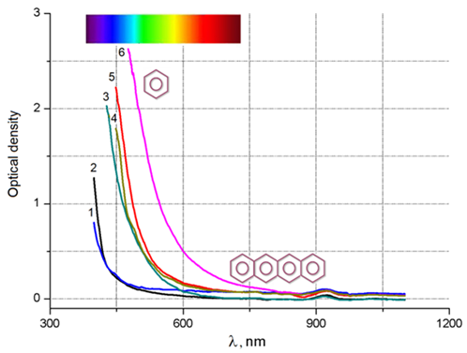
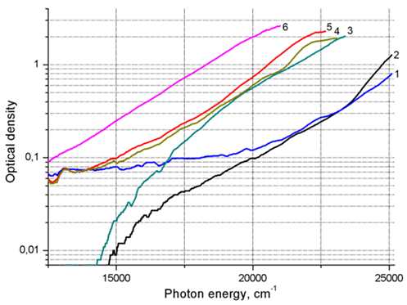
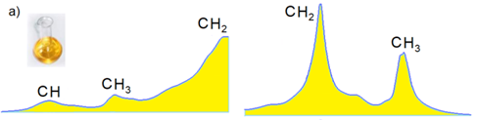
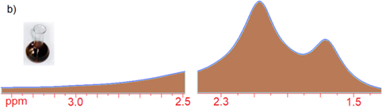
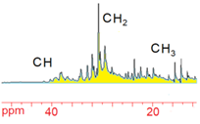
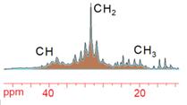
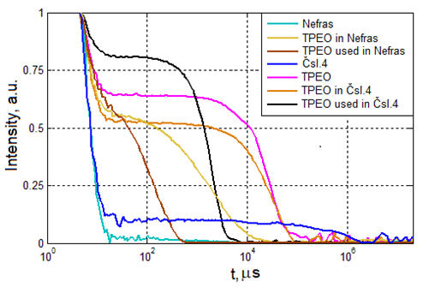
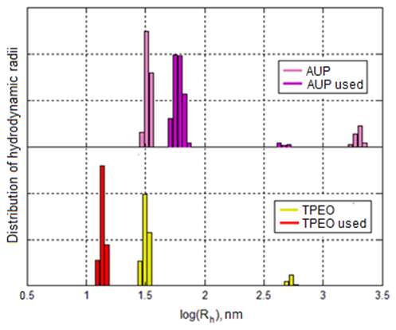
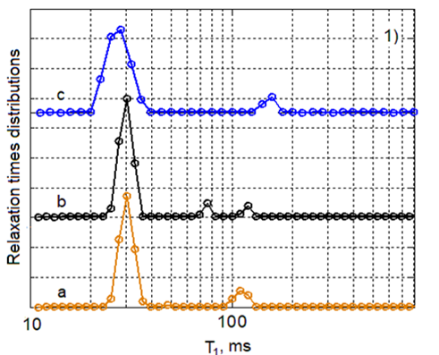
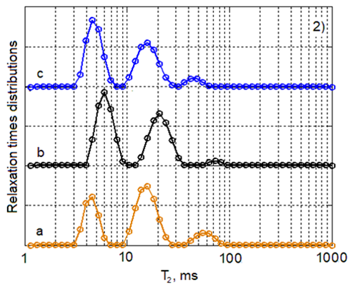
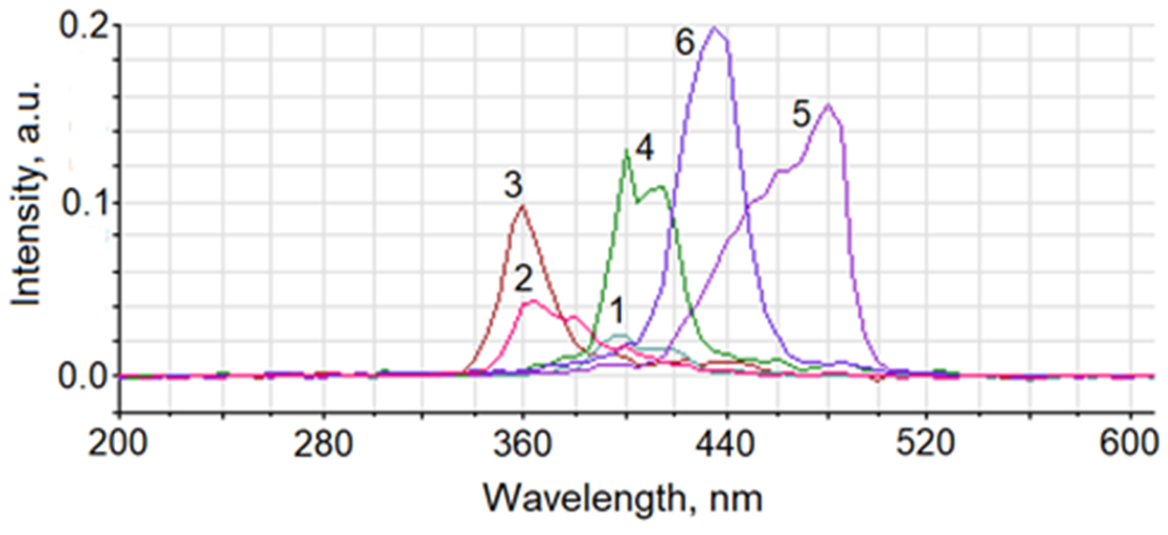
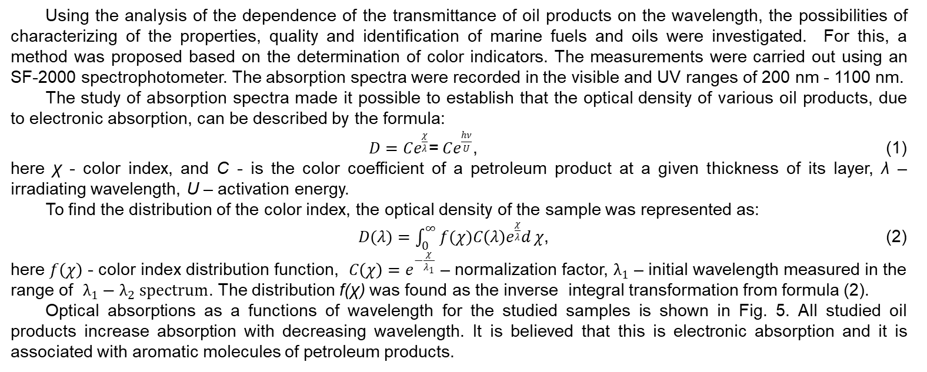
16th – 18th June 2021, Gdynia, Poland
www.transnav2021.umg.edu.pl
N.Ya. Sinyavsky
Kaliningrad State Technical University, Kaliningrad, Russia
Study of ship oil products properties by NMR
and optical spectroscopy
1. Introduction
Studies have shown that the fluorescence spectra in terms of wavelengths, intensity and the shape of spectral lines for marine oil products differ significantly. Consequently, these spectral characteristics can be used for the development of methods for identifying petroleum products, quality control and diagnostics.
Marine diesel engine oil can be used as a diagnostic medium for component malfunctions, as it contains particles resulting from wear. Knowledge of the materials from which the structures of mechanisms are made, based on the results of the analysis of used oil, it is possible to identify a unit that requires repair or replacement.
Changes in the properties of the oil and its composition over time of operation of the diesel engine make it possible to use them for troubleshooting. At the same time, delivery of equipment to the place of repair, dismantling of components and assemblies is not required. The presence of lead, tin and iron in the waste oil indicates wear on the plain bearings and the crankshaft. Overheating of the engine, the ingress of fuel into the oil, the presence of abrasive particles in it causes wear on the pistons and cylinders. Piston ring wear is detected by the presence of chromium in the engine oil, etc.
A wide range of methods for analyzing oil during operation is presented in the reference book [1]. The most common methods for diagnosing the state of the engine, which are proposed to be used, are the granulometric method, the method of IR spectroscopy and the method of ferrography [2].
This work is devoted to improving the operational safety of ships by improving methods for analyzing engine oils of marine engines for the purpose of their diagnostics. An overview of the research results carried out in recent years at the Department of Physics of the Kaliningrad State Technical University is given [3].
2.4 Visible and ultraviolet absorption spectroscopy
Using the analysis of the dependence of the transmittance of oil products on the wavelength, the possibilities of characterizing of the properties, quality and identification of marine fuels and oils were investigated. For this, a method was proposed based on the determination of color indicators. The measurements were carried out using an SF-2000 spectrophotometer. The absorption spectra were recorded in the visible and UV ranges of 200 nm - 1100 nm.
The study of absorption spectra made it possible to establish that the optical density of various oil products, due to electronic absorption, can be described by the formula:
$D=Ce^{\frac{χ}{λ}}$=$Ce^{\frac{hν}{U}}$, (1)
here χ - color index, and C - is the color coefficient of a petroleum product at a given thickness of its layer, λ – irradiating wavelength, U – activation energy.
To find the distribution of the color index, the optical density of the sample was represented as:
$D(λ)=\int_{0}^{∞}{f(χ)C\left(λ\right)e^{\frac{χ}{λ}}d}χ$, (2)
here $f\left(χ\right)$ - color index distribution function, $C\left(χ\right)=e^{−\frac{χ}{λ_{1}}}$ – normalization factor, $λ_{1}$ – initial wavelength measured in the range of $λ_{1}−λ_{2} spectrum$. The distribution f(χ) was found as the inverse integral transformation from formula (2).
Optical absorptions as a functions of wavelength for the studied samples is shown in Fig. 5. All studied oil products increase absorption with decreasing wavelength. It is believed that this is electronic absorption and it is associated with aromatic molecules of petroleum products.
2. Methods, results and discussion
2.1 High-field NMR spectroscopy
The results of the study of fresh and used TPEO oil by 1H and 13C NMR in a strong magnetic field are presented in publications [3]. The Varian-400 spectrometer with superconducting magnet and SpinWorks software were used for measurements.
In fig. 1 shows the signals regions of hydrogen nuclei of aliphatic groups separately. Used oil has broader NMR lines due to changes in its density and viscosity, as well as the presence of particles that broaden resonance lines and reduce resolution.
Figure 1. Range of NMR spectrum of protons (400 MHz) of aliphatic groups: TPEO fresh (a) and used (b).
NMR spectra of C-13 in a strong magnetic field are shown in Fig. 2. In contrast to protons spectra, the carbon NMR spectra show a significant multiplicity of lines, and at the same time, the lines for the used oil practically do not broaden.
Figure 5. Absorption spectra: ecto-diesel (1), SN-150 oil (2), low-viscosity marine fuel (3), marine diesel (4), SN-500 oil (5), TPEO oil (6).
Figure 6. Optical absorption spectra as a function of the quantum energy.
Fig. 6 illustrates essentially the same absorption spectra as Fig. 5, but optical density is plotted on a logarithmic scale as a function of quantum energy. At high photon energies, the spectra in Fig. 6 have almost the same slope for all studied samples. This is due to the fact that all petroleum products have the same type of chromophores.
The results show that the distributions of the χ value are bimodal for ecto-diesel and SN-150 oil, for the rest of the studied oil products they are unimodal.
Thus, the obtained distributions of color parameters and characteristic energies for each oil product are different, which makes it possible to use them to identify these materials and test their quality.
Figure 2. C-13 NMR spectrum (100 MHz) of fresh and used TPEO oil.
2.5 Photon correlation spectroscopy
2.2 NMR relaxometry in a weak magnetic field
A Photocor-FC correlator was used to measure the scattered light autocorrelation functions. The measurement process and the processing of the measurement results were controlled using the Photocor software.
In fig. 7 shows the correlation functions for fresh and used TPEO oils in Nefras and Csl.4 solvents and for the solvents themselves. Changes in the particle size distribution in waste oil (fig. 8) are associated with changes at the molecular level (thermal polymerization, oxidation, evaporation, thermal cracking) and with changes caused by contamination (formation of soot, ingress of water and air, metal particles of rubbing parts).
Relaxation measurements were performed on a Tecmag Apollo NQR-NMR spectrometer in a low magnetic field at a proton frequency of 13.65 MHz using the TNMR program. The spin-lattice relaxation times T1 were measured by the inversion-recovery method. The T2 spin-spin relaxation time was measured by the Carr-Parcell-Meibom-Gill (CPMG) method. To find the distribution functions of the spin-lattice and spin-spin relaxation times f(T1) and f(T2), the obtained experimental arrays were subjected to the inverse Laplace transform.
Fig. 3 illustrates the spin-lattice and spin-spin relaxation times for TPEO marine oil. The relaxation times are due to the contribution of various hydrocarbons in the composition of the samples. The dynamics of the molecules of these hydrocarbons, because of its different structure of the molecules and their mass, determines the form of the T₁ and T₂ distributions. The multimodality of distributions is determined not by the same mobility of molecules. Not mobile molecules with high molecular weight give short T₁ times, and light and mobile - ones long. The positions of the peaks on the distributions depend not only on the composition of hydrocarbons, but also on the presence and types of additives that improve certain properties of the oil.
In used marine engine oil, all three peaks in the distribution of relaxation times T₂ are shifted in comparison with fresh oil in the direction of longer times. This may indicate a decrease in the molecular weight and an increase in the mobility of some hydrocarbons. On the distribution of relaxation times T₁ for used oil, the main peak is in the short-time region and does not shift with respect to the main peak for fresh oil. An experiment with heating fresh oil (curve "c" in Fig. 3) indicates that changes in used oil are not limited to oxidation at high temperatures, but are also determined by other factors.
Figure 7. Correlation functions of solvents and TPEO oil, fresh and used.
Figure 8. Distributions of hydrodynamic radii of particles of TPEO oil and AUP oil.
The nature of the distributions of the hydrodynamic radii of the particles in the studied samples is predominantly bimodal. The distributions peaks are located in two main domains: from 10 nm to 100 nm and above 100 nm, respectively.
Thus, the method of photon correlation spectroscopy was used to study a number of fresh and used motor oils, which made it possible to obtain the distributions of correlation times, diffusion coefficients and hydrodynamic radii of particles of these substances.
Figure 3. Curves of distributions of times T1 (1) and T2 (2) for fresh TPEO oil (a), used 300 hours (b) and fresh oil after 25 hours heating at 85°C (c).
3. Conclusion
Thus, the times of spin-lattice relaxation T1 and spin-spin relaxation T2 contain information on the molecular dynamics of hydrocarbon macromolecules and their constituents. Engine oil quality diagnostics can be performed using distributions curves T1 and T2. The distribution curves of the times T1 and T2 are unique for each type of fuel and lubricant, i.e. are, as it were, his passport and this allows the identification of the oil product, the determination of its quality and the detection of deviations from the standards.
The highly informative ¹H and ¹³C NMR method in a strong magnetic field makes it possible to determine the composition of hydrocarbons, additives and impurities, i.e. characteristics of petroleum products that determine many technical parameters of the engine. However, to diagnose the quality of engine oil, this method involves the use of bulky and expensive laboratory equipment and requires a lot of time for analysis. NMR ¹H relaxometry of low resolution using distribution functions f(T₁) and f(T₂) makes it possible to diagnose used engine oil and draw conclusions about engine faults.
It makes sense to use fluorescence spectra to determine the properties of marine oil products. In this case, informative parameters can be the shape line, intensity, and wavelength interval of the fluorescence spectrum. The study of absorption properties in the visible and UV ranges for samples of various marine fuels and oils made it possible to establish the dependence of their optical density, due to different chromophores, on the irradiation wavelength. It is shown that the distributions of color parameters for different samples are significantly different. The modality of the distribution of this parameter, the position and intensity of the peaks depend on the content and mass of aromatic hydrocarbon molecules in the composition of petroleum products.The possibilities of diagnostics of the engine by used oil by the method of optical correlation spectroscopy have been investigated. The effect of oil viscosity on particle size distribution is shown, which, depending on the reasons (engine malfunctions), can change both upward and downward. By the nature of the distribution of large particles, it was found that the level of aggregation or micelle formation of the polymer of the viscosity modifier decreases in the waste oils.
The results of the performed radiospectroscopic and optical studies show that these methods make it possible to obtain parameters suitable for the analysis of engine oil and for obtaining diagnostic data on the state of the engine for the used oil.
2.3 Fluorescence spectra
Analysis of the fluorescence spectra of petroleum products for the purpose of their identification and quality control was carried out. The experiments were carried out on a Fluorat-02-Panorama device. The wavelength range of excitation and measurement of fluorescence was from 200 nm to 860 nm.
The obtained 1D fluorescence spectra of various petroleum products are illustrated in Fig. 4. Comparison of the fluorescence intensities shows that the minimum radiation intensity gives low-viscosity fuel. The SN-500 oil gives the highest intensity. TPEO oil has the largest width of the radiation spectrum. All investigated fluorescence spectra of petroleum products have a complex shape. This is due to the presence of several different types of fluorescent particles in the samples.
Figure 4. One-dimensional fluorescence spectra of various petroleum products: LVMF (1), SN-150 (2), ecto-diesel (3), marine diesel fuel (4), TPEO (5), SN-500 (6).
References
Oil Analysis Handbook for Predictive Equipment Maintenance. Available online: https://www.spectrosci.com/default/assets/File/SpectroSci_OilAnalysisHandbook_FINAL_2014-08.pdf (accessed on March 14, 2021).
G.I. Berestova, “Assessment of the state of engine oils in marine diesel engines by the complex method of ferrography and infrared spectroscopy”, Dissertation. Murmansk, Russia, 178, 2002.
N.Ya. Sinyavsky and etc. Marine Intelligent Technologies, vol. 42 (4), 82-90, 2018; vol. 37 (3), 62-66, 2017; vol. 42 (4), 91-97, 2018; vol. 45 (3), 89-93, 2019; vol. 4 (1), 103-108, 2020

